Slide 1
Convolutional Neural Networks
The advantages of partially connected layers

Slide 2
The perception preprocessor
"Perception largely takes place outside the realm of our consciousness, within specialized visual, auditory and other sensory modules in our brains. By the time sensory information reaches our consciousness, it is already adorned with high-level features." -Aurelien Geron

Slide 3
Studying the Visual cortex
Work by Hubel and Wiesel in the 1950s and 1960s showed that cat and monkey visual cortexes contain neurons that individually respond to small regions of the visual field.
Neurons react to specific primitive visual characteristics – horizontal, vertical, diagonal line orientations.
Some neurons react to larger receptive fields- suggesting that they process the outputs from primitive receptive field neurons.

Slide 4
Local Receptive Field
Neurons in the visual cortex only react to stimuli located in a specific region of the visual field. (local receptive fields of different neurons may overlap)

Slide 5
neocognition
A hierarchical, multilayered artificial neural network proposed by Kunihiko Fukushima in the 1980s.

Slide 6
Convolution
1998- landmark paper Yann LeCun, Leon Bottou, Yoshua Bengio and Patrick Haffner – introduce the LeNet-5 architecture.
Introduced Convolution layers and pooling layers.
Widely used to identify handwritten numbers on checks.

Slide 7
CNN Advantages
Use relatively little pre-processing compared to other image classification algorithms.
Not restricted to visual perception- processing tasks include: voice recognition and natural language processing.
Have managed to achieve superhuman performance on some complex visual tasks.

Slide 8
Partially connected layers
CNN's are more efficient for image recognition than regular fully-connected deep neural networks by providing 'partially connected layers'.
Consider a fully connected network where a 100x100 pixel image contains 10,000 pixels each connected to 1,000 first layer neurons yields 10,000,000 connections.
3X these connections if you want to process the RGB components of the image separately.

Slide 9
convolution
Convolution – A convolution is an integral that expresses the amount of overlap of one function 'g' as it is shifted over another function 'f'. It therefore "blends" one function with another.
Commonly used in signal processing.

Slide 10
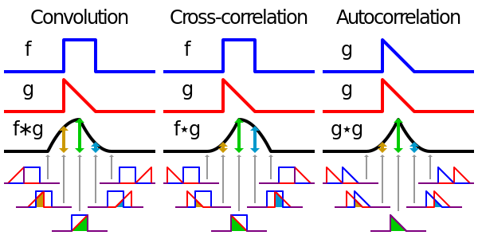
Signal processing

Slide 11
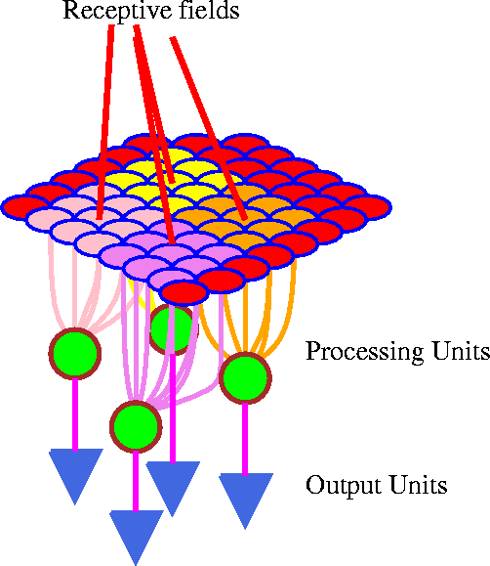
CNN processing is different
CNN's do not process information in a single dimension as has been shown by all machine learning approaches to this point.
CNN's operate on receptive fields- which are two dimensional.

Slide 12

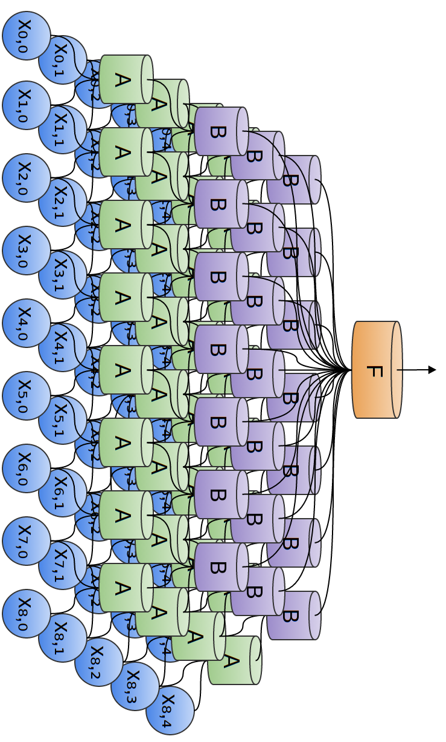
Two dimensional neural configuration

Slide 13
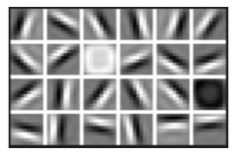
Convolution Kernel (Filter)
A neuron's weights can be represented as a small image the size of the receptive field. This is known as a 'convolution kernel' or a 'filter'

Slide 14
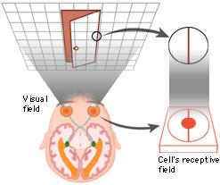
Receptive field and filter
In this image, a vertical line filter is triggering a response in a particular neuron.
This filter matrix is all 0's except for a central column which is full of 1's.

Slide 15
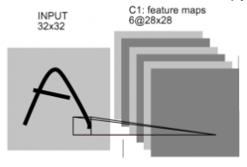
Feature map
A feature map is a full layer of neurons using the same filter.
Within a feature map, all neurons share the same weight and bias parameters.

Slide 16
Stacking feature maps
It is common to stack multiple feature maps into a single convolution layer.
The image to the right shows feature maps that identify horizontal lines, vertical lines, diagonal lines, etc.

Slide 17
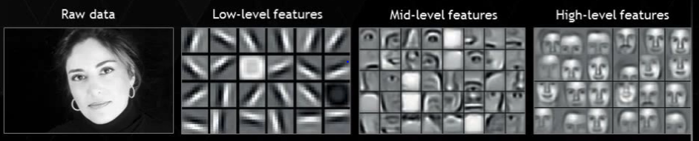
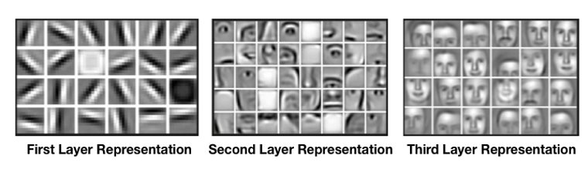
Feature layers – Facial recognition

Slide 18
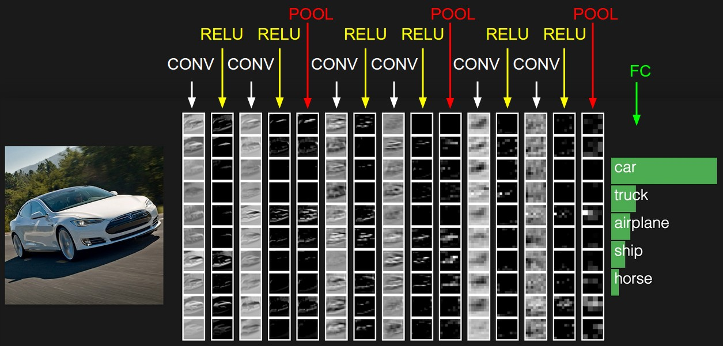
Hidden CNN layers - transportation

Slide 19
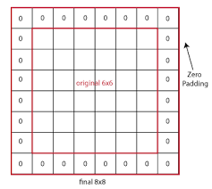
Zero padding
Zero padding refers to the practice of adding zeroes to neural network input data to preserve a consistent aspect ratio.

Slide 20
Zero padding - advantages
It's easier to design networks by preserving height and width and not having to worry about tensor dimensions when going from one layer to another because dimensions are consistent.
It allows us to design deeper networks. Without padding, reduction in volume size would reduce too quickly.
Padding actually improves performance by keeping information at the borders.

Slide 21
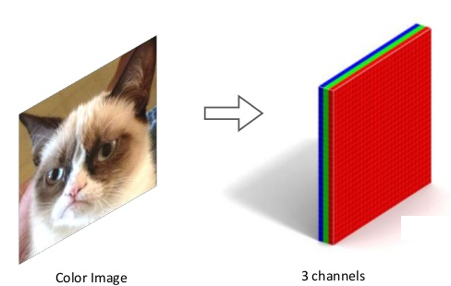
rgb
For color images, a feature map is typically associated with a color channel. (ie. RGB) Thus a given filter may be implemented multiple times- one for each color channel.

Slide 22
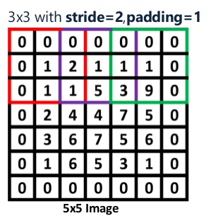
stride
Stride is how much a filter is shifted on an image with each step.
The filter slides over the image, stopping at each stride length, and performs the necessary operations at that step.

Slide 23
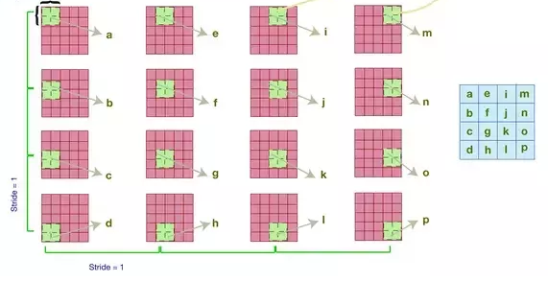
Stride in two dimensions

Slide 24
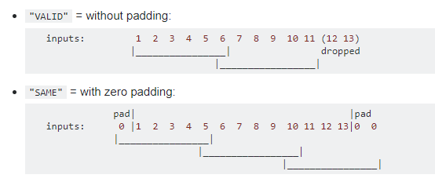
padding
In this example:
Input width = 13
Filter width = 6
Stride = 5
Notes:
"VALID" only drops the right-most columns (or bottom-most rows).
"SAME" tries to pad evenly left and right, but if the number of columns to be added is odd, it will add the extra column to the right, as is the case in this example (the same logic applies vertically: there may be an extra row of zeros at the bottom).

Slide 25
Cnn memory pressure
Convolution layers require a huge amount of memory during training.
The reverse pass of backpropagation requires all of the intermediate values computed during the forward pass.
Reduce Memory:
Reduce the mini-batch size
Increase stride value
Remove layers
Distribute the training (using cloud resources)

Slide 26
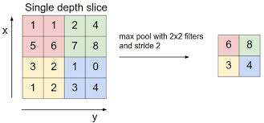
Pooling layer
The purpose of pooling layers is to shrink or subsample an image in order to reduce the computational load and memory pressure.
Mean or Max values are typically supplied to the pooling layer.
Max Pooling

Slide 27
Pooling Depth
Pooling layers are typically created for every input channel. Thus for an RGB image, where each color component is processed on a separate layer- there is a corresponding pooling layer for each color component.

